Slide 1
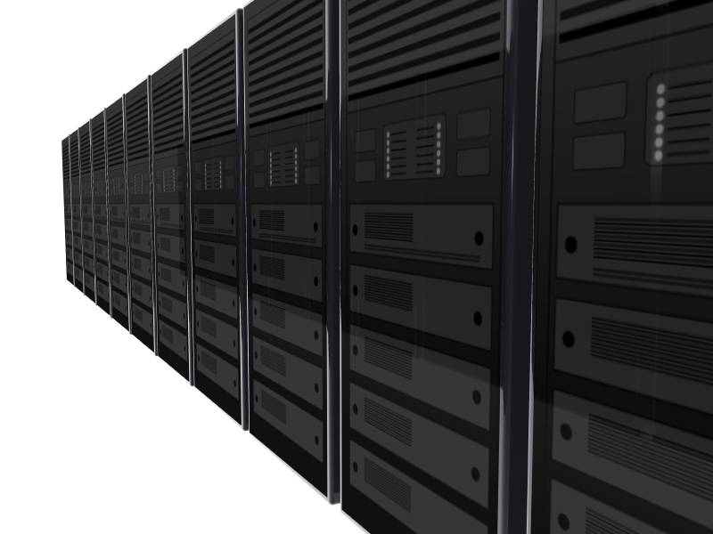
The Economics of
Cloud Computing
Bill Sempf

Slide 2
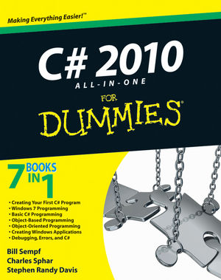
A little about me
Software Architect
Author
Family Guy
Ninja
Brewer
Locksport Enthusiast

Slide 3

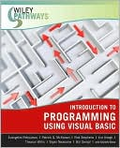
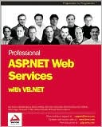
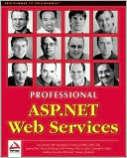
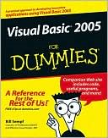
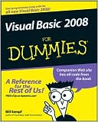
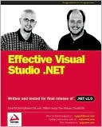
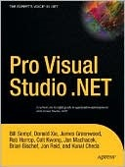
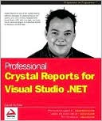
I’ve been writing for a bit

Slide 4
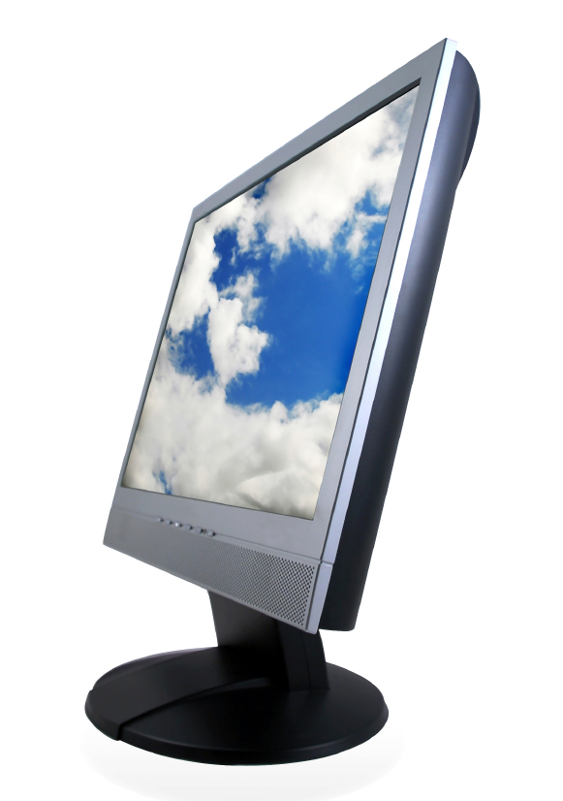
Some realities of IT
The origins of cloud
Contemporary offerings
The accounting involved
Economics
Implementation details

Slide 5
Some realities of IT
The origins of cloud
Contemporary offerings
The accounting involved
Economics
Implementation details

Slide 6
Cost Center Accounting
CEO
Board
Accounting
IT
Sales
Production
Cost Centers
Profit Centers
Notes:
Mid-90s corporate accounting created cost center bookkeeping
You trade, like a miniature economy
The profit centers ultimately got to call the shots.
IT Managers became destructively frugal to preserve jobs and bonuses.

Slide 7
The Dot Com Bubble
CEO
Board
Accounting
IT
Sales
Production
Cost Centers
Profit Centers
Notes:
Fast forward to the early 2000s
IT shows that it can be a profit center (with web stores and data mining and the like)
The Golden Age.

Slide 8
The Bubble Bursts
CEO
Board
Accounting
IT
Sales
Production
Cost Centers
Profit Centers
Notes:
And then the bubble burst.
This time, though, IT managers have more tools in their bag:
- A lot more off-the-shelf software to work with
- Open Source
- Virtualization
Cloud computing is a natural offshoot of virtualization and internetworking
It offers a shift in the cost buckets.

Slide 9
Some realities of IT
The origins of cloud
Contemporary offerings
The accounting involved
Economics
Implementation details
Notes:
So where did cloud really begin?
Further back than you think.

Slide 10

John McCarthy, 1961
“computation may someday be organized as a public utility.”
Notes:
John wasn’t talking about internet access.
He meant the virtual crunching of numbers required to run businesses.

Slide 11

Notes:
Cloud computing is when a company or organization connects many computers to distribute processing power.
As generally implemented, it is processing power virtualized and accessed over the Internet.
The general idea is that of a user sitting at a terminal that uses hosted applications taking advantage of services, storage space and resources provided on another computer, through an internet connection.

Slide 12
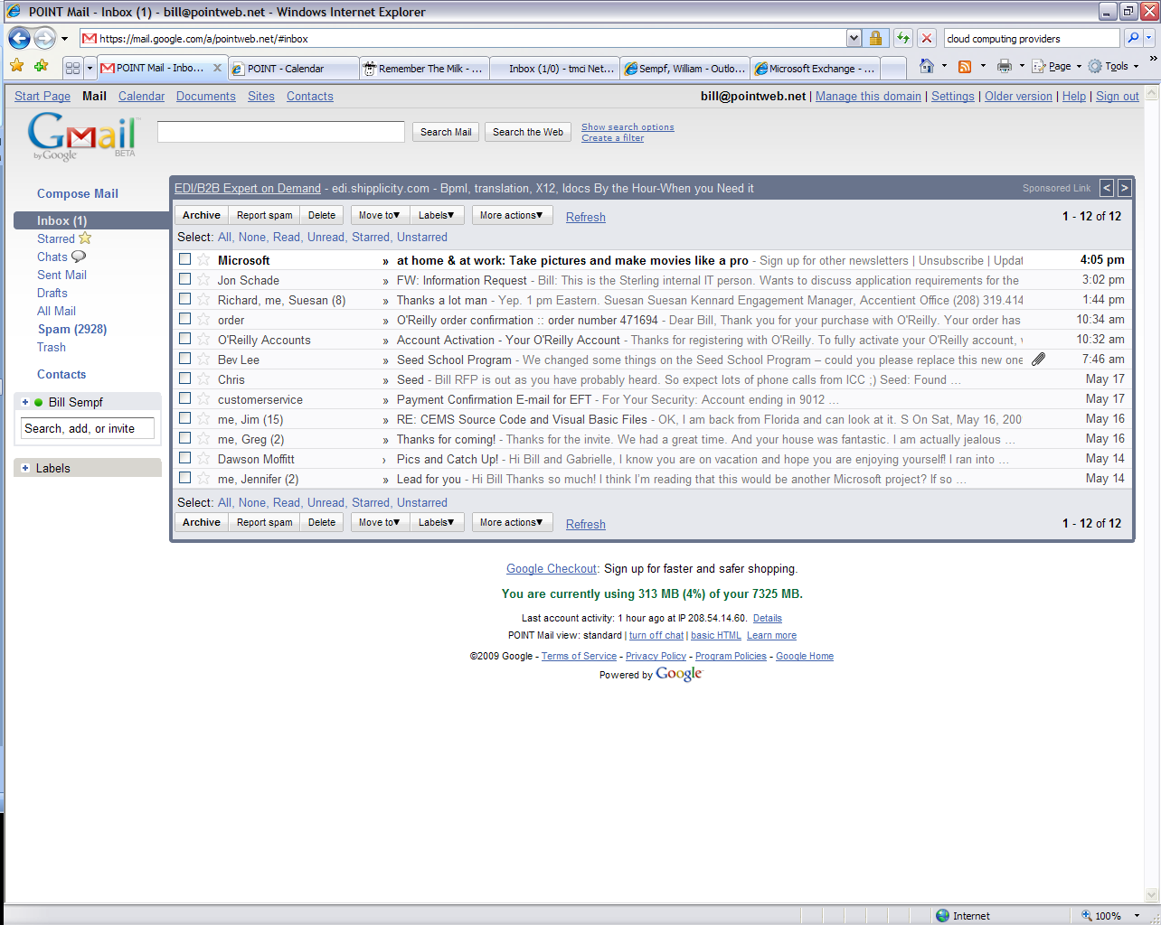
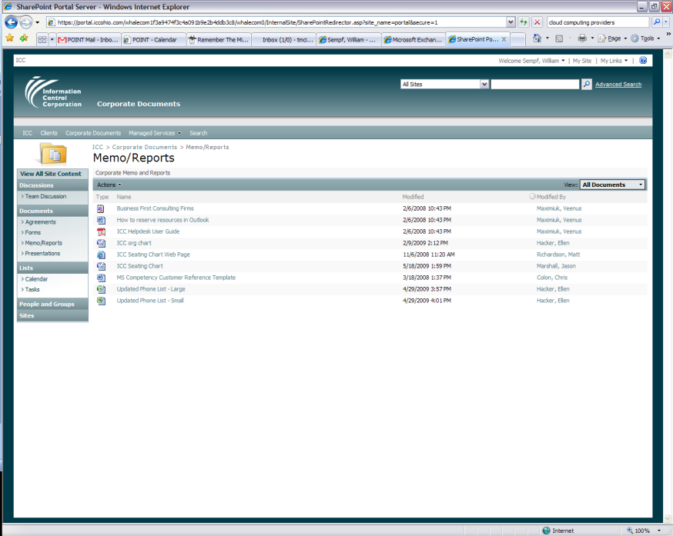
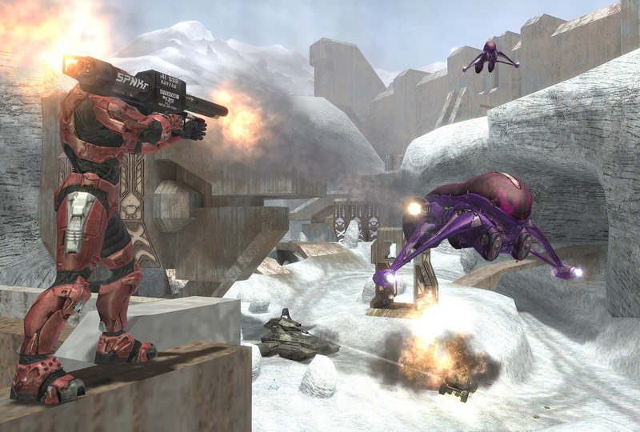
Applications in the cloud
Notes:
Average user:
doesn’t use Outlook Express, they use Gmail
don’t save docs on C:, load them on sharepoint
don’t gather at the house for a lan party, you play virtual opponents in a virtual space

Slide 13
The cloud defined
A scalable application hosting space,
with specific offered services,
billed like a utility.
Notes:
Web app hosting is nothing new
Been around since the beginning
Free to thousands a month
Provide access to libraries
Open an access point to the Internet for small and large apps
Services are somewhat new
Used to be ASP.NET or PHP or Perl – local libraries
Now SOAP or REST based services, some constrained to cloud apps
A distributed application platform
Billing
Cable billed like a service – you pay if you use it or not
Electric billed like a utility – use a little pay a little, use a lot pay a lot.

Slide 14
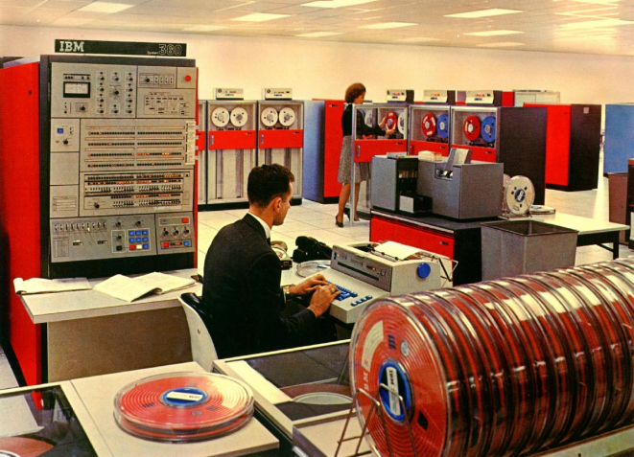
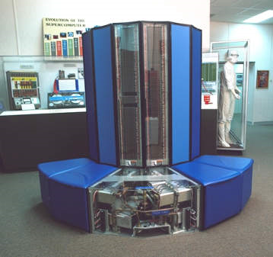
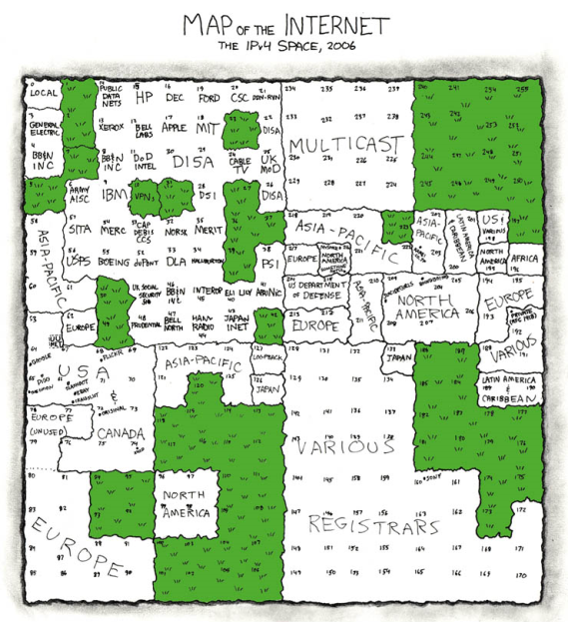
The old is new again
Notes:
Let’s take a trip into the past.
IBM was already providing TSO to small orgs
Cray put ‘smaller’ servers into ever smaller segments to pigeonhole computing use.
The Web itself is a cloud computing environment.
Take TSO for instance
Set up by large orgs to share application load
Several services were offered,
programming languages,
storage
printing
The service was billed by
hours connected
seconds of CPU time
storage space
Sounds strangely familiar.

Slide 15
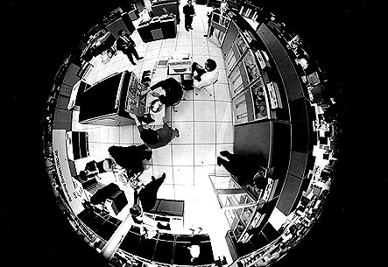
IBM had it right?
Notes:
There are clearly come differences between TSOs and cloud.
TSOs aren’t used anonymously
TSOs designed for number crunching specifically
Still, clearly the beginning

Slide 16
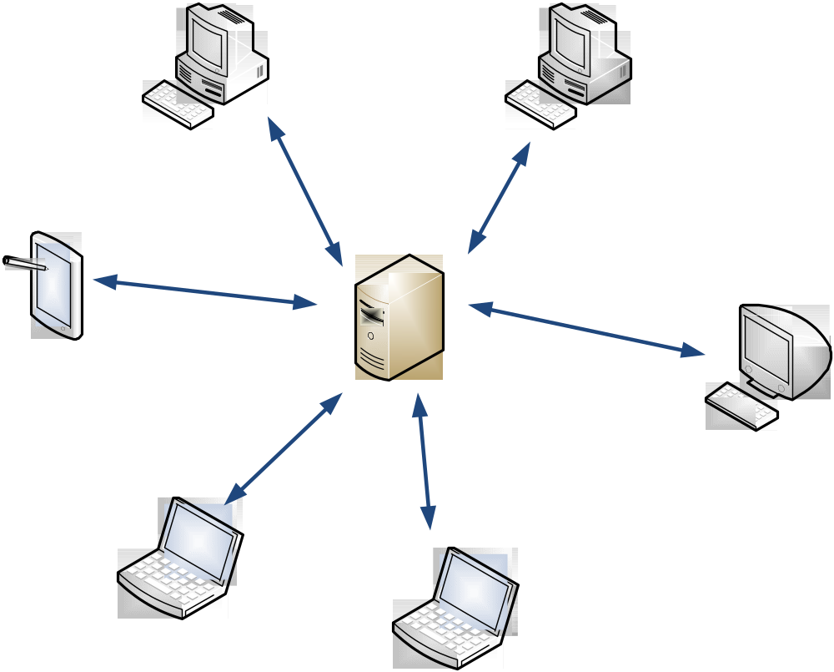
Client Server computing
Notes:
Client server systems are similar, really
We have a network of clients with a powerful machine in the center
How is it different from Mainframe? Clients share in the processing.
BUT, parallel processing not easy on a client, and UI hard on a server (at least until recently)
If you had a lot of data to munge, and wanted a UI, client/server was your only shot

Slide 17
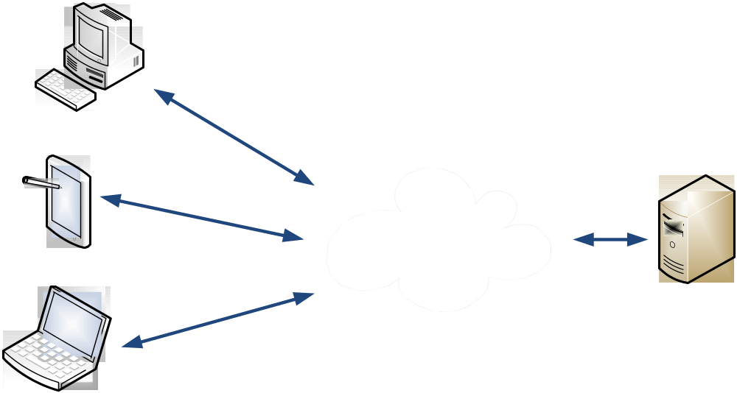
Morph to the Internet
Notes:
Client server systems morphed into internet servers
Network became more sophisticated, bandwidth greater.
Growing ubiquity of the internet made the reach greater and the experience richer.
Soon, specialization of server triumphed over the brawn of mainframes.
The reach of the internet triumphed over the flexibility of the client/server

Slide 18
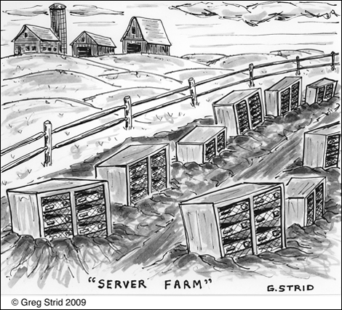
The Server Farm
Notes:
Searching 13 billion pages of information drove more specialized server systems
Gradually, a new paradigm was born – the server farm.
A lot of servers work together to solve a very specific set of problems.
Two technologies are the technological backbone:
Virtualization
Shard computing
The cloud is the same as a big server farm, as long as it meets our three requirements. Same tech.

Slide 19
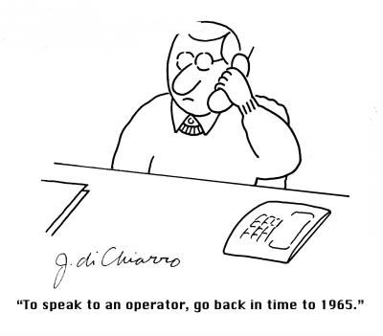
Press one for more answers
Notes:
The virtualization of the answering machine
direct dial phones (no live operators) drew need for tape recordings.
Plays from one, records to another.
Then we use a chip to record and play
Then the whole device went digital
Logic and storage ALL zeros and ones
Abstract the machine away
Now, we don’t even have machines at all – it is a service of the phone company

Slide 20
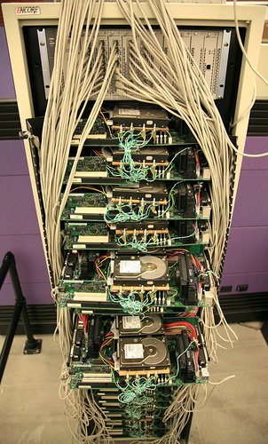
Shard Computing, circa 1999
Notes:
Shard computing is simply the practice of putting a little bit of the data in
each of several physical servers to distribute the load in a parallel way
Sorta the opposite of virtualization, but not really.
Send request to all machines, and the will all respond
Only one has answer
Birth of the cloud
served as a utility
bunch of machines
basic definition met

Slide 21
Some realities of IT
The origins of cloud
Contemporary offerings
The accounting involved
Economics
Implementation details
Notes:
So we have reached the current time.
Where does that leave us?

Slide 22

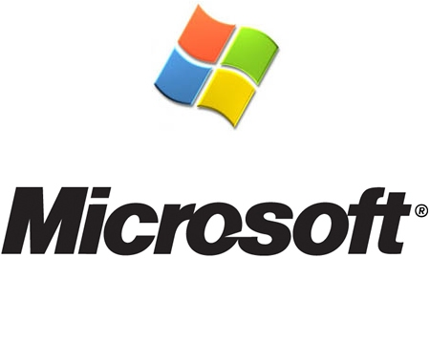

The big providers
Notes:
Amazon started things off
partitioned hosting space
Offered hosting that would ebb and flow
The masters uses time in April, indy500 gets it in may
Microsoft and Google were next.
Other web 2.0 companies – many vertically focused
force.com – sales
Intuit Partner Network
EMC
Now web 3.0 companies
Eucalyptus
iCloud
3Tera
Paving the way to new ideas.
Three pasic types of services offered by cloud providers in general – well represented by the big players.

Slide 23
The big provider types
Infrastructure As A service
Software As A Service
Platform As A Service
Notes:
There are three service provider types, represented well by the three big players – that’s why I chose them.
Platform
Effectively indistinguishable from an Application Service Provider
Gives you a place to deploy, and a programmable superstructure
Infrastructure
Effectively indistinguishable from a hosting company.
Gives you a machine, good luck
Software as a service
Gives you a finished product.

Slide 24
Amazon S3 - IAAS
Symmetry
Autonomy
Decentralization
Failure Tolerant
Asynchrony
Simplicity
Controlled Parallelism
Local Responsibility
Decomposition
Controlled Concurrency
Notes:
Write, read, and delete objects containing from 1 byte to 5 gigabytes of data each. The number of objects you can store is unlimited.
Each object is stored in a bucket and retrieved via a unique, developer-assigned key.
Authentication mechanisms are provided to ensure that data is kept secure from unauthorized access.
The service uses standards-based REST and SOAP interfaces designed to work with any Internet-development toolkit.
And it is built to be flexible so that protocol or functional layers can easily be added.

Slide 25
Microsoft Azure - PAAS
Azure
Development Tools
Simple Data Storage
Computation
Notes:
Really an operating system, hosts the Azure Services Platform.
Microsoft products as services
Run .NET code in the cloud – basically just IIS.
No file system, storage API for scratch storage
Web based management console.
Uses Code Access Security
Full Trust supported for WF and EWCF
FastCGI in there for Perl and PHP and the ilk.
Barely distinguishable from a usual application service provider.

Slide 26
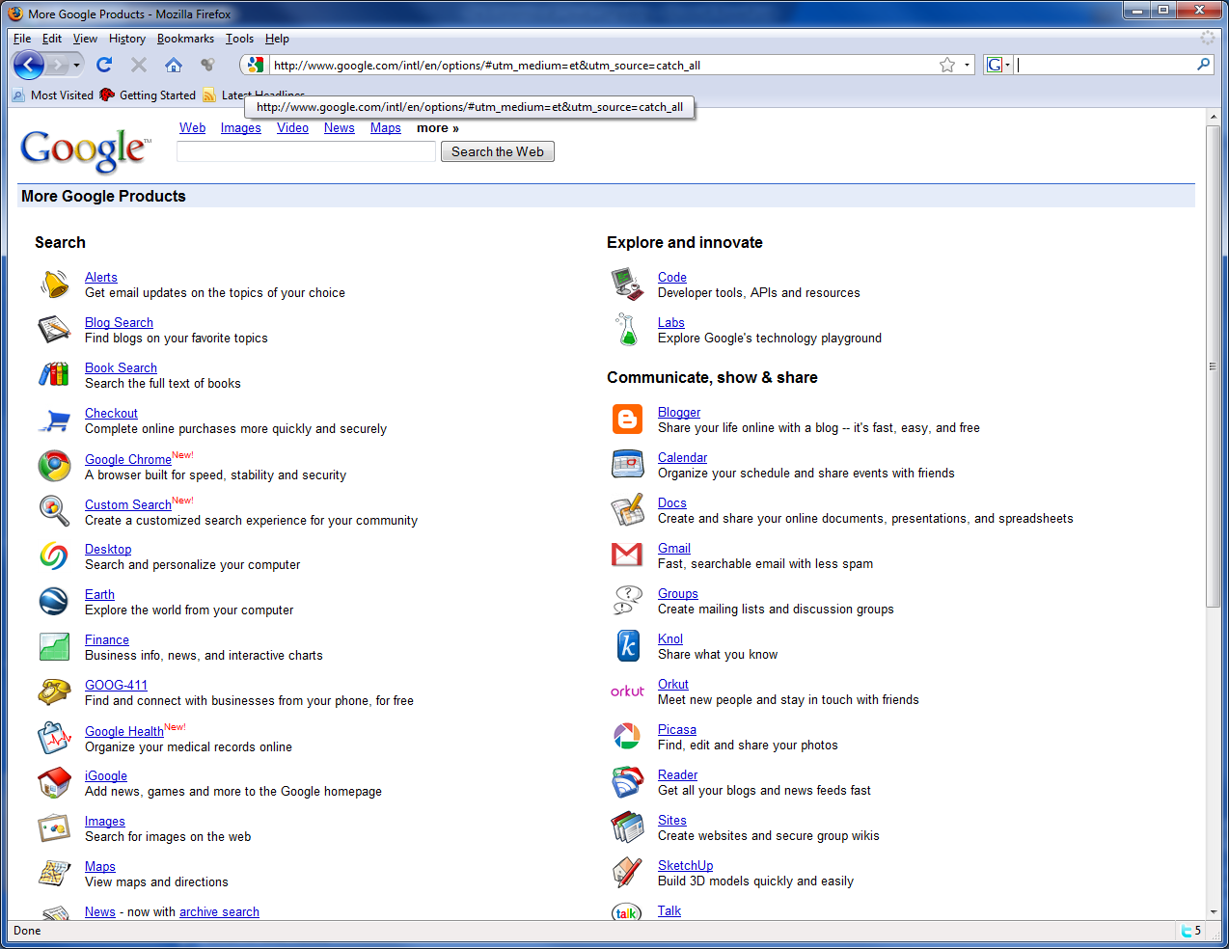
Google Apps - SAAS
Notes:
This isn’t the app engine I am talking about here – that is really Platform as a service.
This is the apps they provide, themselves. Like Gmail.
provide client-driven access of these components through Google Gears,
For example, take Remember the Milk. You can use the services in the gmail software and make a mashup.

Slide 27
Some realities of IT
The origins of cloud
Contemporary offerings
The accounting involved
Economics
Implementation details
Notes:
There are three ways to look at this.
There is the way that the business owners view it, the way that the economists view it, and the way that the accountants view it.
The way the business owners see it as cash in hand - finance.
The economists view it as effect on the community - economics.
The accountants have a big list of rules. They view it THAT way. You all know how accountants are.

Slide 28
Dollars and Sense
Purchase - on Premise
  $ 15,000 - Quad-Core Servers ( 5 x 3,000 each )
  $ 750 - 1/2 Rack + Gigabit Switch
  $ 15,750 - Total Hardware cost
  $ 5,800 = Annual amortized cost, 5% over 3 years
  $ 0 - Assuming no incremental real estate cost
  $ 2,000 - Annual power & AC cost
  $ 7,800 - Total annual cost on premise
Purchase - at Colo
  $ 8,000 - Colo fees; 1/2 Rack + power + bandwidth
  $ 5,800 - Annual amortized cost
  $ 13,800 - Total annual cost at Colo
Cloud
  $ 35,040 24x7x365 Amazon EC2
    ( $.80 per high CPU Server instance hour )
  $ 8,320 40 hours x 52 weeks
  $ 688 40 hours x 4.3 weeks
Source: Open Source Magazine
Notes:
The conclusion here?
Cloud isn’t a good financial option.
But he fails to take into consideration two very important things.

Slide 29
Dollars and Sense
Purchase - on Premise
  $ 15,000 - Quad-Core Servers ( 5 x 3,000 each )
  $ 750 - 1/2 Rack + Gigabit Switch
  $ 15,750 - Total Hardware cost
  $ 5,800 = Annual amortized cost, 5% over 3 years
  $ 0 - Assuming no incremental real estate cost
  $ 2,000 - Annual power & AC cost
  $ 7,800 - Total annual cost on premise
Purchase - at Colo
  $ 8,000 - Colo fees; 1/2 Rack + power + bandwidth
  $ 5,800 - Annual amortized cost
  $ 13,800 - Total annual cost at Colo
Cloud
  $ 35,040 24x7x365 Amazon EC2
    ( $.80 per high CPU Server instance hour )
  $ 8,320 40 hours x 52 weeks
  $ 688 40 hours x 4.3 weeks
Notes:
The first is the difference between operational and capital expenses, which makes a difference to the accountants.
Buying stuff that goes out of date, like computers, is baaaad.

Slide 30
Dollars and Sense
Purchase - on Premise
  $ 15,000 - Quad-Core Servers ( 5 x 3,000 each )
  $ 750 - 1/2 Rack + Gigabit Switch
  $ 15,750 - Total Hardware cost
  $ 5,800 = Annual amortized cost, 5% over 3 years
  $ 0 - Assuming no incremental real estate cost
  $ 2,000 - Annual power & AC cost
  $ 19,200 – Annual labor
  $ 27,000 - Total annual cost on premise
Purchase - at Colo
  $ 8,000 - Colo fees; 1/2 Rack + power + bandwidth
  $ 5,800 - Annual amortized cost
  $ 13,800 - Total annual cost at Colo
Cloud
  $ 35,040 24x7x365 Amazon EC2
    ( $.80 per high CPU Server instance hour )
  $ 8,320 40 hours x 52 weeks
  $ 688 40 hours x 4.3 weeks
Notes:
The second is paying for someone to manage it, which is a dramatic oversight, and makes difference to the business owners. The grid should look a lot more like this:

Slide 31
Dollars and makes more sense
 | Internal IT | Managed Services | The Cloud
Capital Investment | $40,000 | $0 | $0
Setup Costs | $10,000 | $5,000 | $1,000
Monthly Services | $0 | $4,000 | $2,400
Monthly Labor | $3,200 | $0 | $1,000
Cost Over 3 Years | $149,000 | $129,000 | $106,000
Source: Cloud Application Architectures, George Reese. O’Reilly, 2009.
Notes:
So this is about the money.
Hate to say it, I really hate to say it, but what is going to make cloud computing take off is
the financial an economic realities of hardware,
staff and
power consumption.
Each of our money wizards has a perspective on this, and we will take them one at a time.

Slide 32
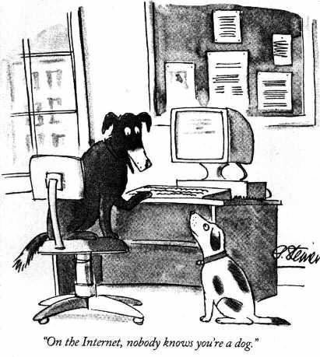
You can be who you wanna be
Notes:
Upfront investment is one of the most important considerations for the small business owner especially.
While the early pundits espoused the Internet as a way that David could slay Goliath because “on the internet you can look as big as you want to be.” But this isn’t true, nor was it ever.
Even the most modest success story required pretty beefy server power.
Once your big idea became even slightly successful, your company had to be prepared to pay the piper in terms of hosting bills or your own servers and bandwidth.
The large enterprise has the same problems with cash. Any application that a Nationwide or Chase Bank puts on the internet is going to have an instant audience, and will have to have the server power to support it out of the gate.
Additionally, large organizations are lacking that entrepreneurial spark, so there is also the software development and integration costs to consider.

Slide 33
Scalability
Application Domain
Redundancy
Bandwidth
Sockets
Storage
Notes:
While corporate environments have sophisticated server farms, and sometimes even a good virtualization strategy, they still have to be able to scale.
Buying enough server hardware and licenses to support the most traffic a company like Nationwide will ever have is very expensive.
Cloud computing provides a solution for both large and small businesses.
Because it is priced like a utility, the organization only has a cash layout for the initial use.
This benefits the small company because until critical mass is reached the costs are very low.
The large company only has to pay for the usage for applications today –
and tomorrow they can add more with only the marginal increase in cost.
All of this leads to an increase in cash on hand.
This provides two very important pieces of the puzzle –
the small companies can grow organically
and the large companies can buy the small companies.
And the cycle continues.

Slide 34
Assets and Expenses
 | Internal IT | Managed Services | The Cloud
Capital Investment | $40,000 | $0 | $0
Setup Costs | $10,000 | $5,000 | $1,000
Monthly Services | $0 | $4,000 | $2,400
Monthly Labor | $3,200 | $0 | $1,000
Cost Over 3 Years | $149,000 | $129,000 | $106,000
Notes:
Accountants tend not to care about cash – they see everything in terms of accrual accounts. The bucket that something goes in is as least as important as the amount that goes in. They view our little list of costs like this.
The reason for this is that capital investment is an Asset and everything else is an Expense.
To tech companies Assets are a bad thing, unless they are intellectual property.
In general, computers are a bad investment, and that is what technology companies buy.
A capital asset is something that provides worth to a company, like a building.
When you buy a building, it will help you earn money.
Since it has a lifespan, you are expected to amortize the costs against your organization for the life of the asset.
If the IRS says a building lasts 20 years, then you get the tax benefits of buying that building slowly, over those 20 years.
Computers are capital assets too, but they have a really short lifespan comparatively.
Problem is, if you spend $40,000 on computers in year one and make zero money with them while you are starting up,
you still don’t even get to write all of those computers off on your taxes in year one.
By comparison, cloud services are considered a utility.
Utilities are an Expense, and go in a whole different bucket.
Expenses are not assets, and can be fully written off against your bottom line for the IRS.
This means there is a significant tax savings associated with ‘renting’ your computer time rather than buying it.
That makes the accountants happy.

Slide 35
Some realities of IT
The origins of cloud
Contemporary offerings
The accounting involved
Economics
Implementation details
Notes:
Economics can’t always be boiled down to guns and butter.
However, if the use of cloud computing does in fact reduce the cost of the upfront investment,
then it has the effect of reducing the price of a product when demand is low,
effectively making more of the product available when demand grows.
Cloud Computing has the effect of actually slightly changing the shape of the supply curve.

Slide 36
Economics refresher
Price
Supply
Demand
Quantity
Notes:
I barely remember my microeconomic theory and I nearly minored in the stuff. Let’s refresh.
The vertical axis is price of a good and the horizontal axis is the quantity available.
Usually goods are commodities, like guns or butter,
but in this case we are talking about whatever computer services you are selling.
Inside the graph is a supply line,
which shows that the cost, and thus price, increases when quantity produced increases.
There is also a demand line,
which displays the quantity that is likely to be purchased at a certain price.
This number is lower when the price is higher.

Slide 37
Economics refresher
Price
Supply
Demand
Quantity
Notes:
Reducing the fixed cost has the effect of shifting the entire supply curve downward.
This means that the company can stay in business longer, even selling a minimal quantity of the good.
Reducing the upfront variable cost has the effect of reshaping the line making the earlier part of the curve flatter.
This has the effect of keeping price lower, longer, driving more demand for the good, earlier.
Craigs list
Used Cloud early.
low upfront allowed them to spend limited capital elsewhere.
Then, when demand grew, they just scaled their cloud
Works for any entrepreneurial organization
ISP = fixed service expense
Buy your own server = upfront capital expense
cloud gives you a utility
Large companies too
Gotta pay server admins even if noone uses the app
Cloud introduces variable costs
more variable cost means less risk

Slide 38
Economics of the situation
Less cash at outset
More freedom for small firms
Less risk for large firms
Tax benefit
Reduces capital outlay
Moves costs to the Expense column
Changes the supply curve
Fixed cost reduction lowers curve
Variable costs flatten the shape
Notes:
So where does that leave us?
Cloud computing
requires less cash at the outset, lowering the barrier to entry for entrepreneurial firms.
It has a significant tax benefit reducing the number of capital assets that the organization must procure before providing the service.
Finally, it lowers and flattens the supply curve, driving more demand earlier.

Slide 39
Some realities of IT
The origins of cloud
Contemporary offerings
The accounting involved
Economics
Implementation details
Notes:
Let’s take a few minutes and look at how cloud computing can be implemented in your organization.

Slide 40
Implementation
Select a vendor
Prepare the application
Change to processes
Notes:
First, you must take a broad look at the applications under your control and
see how they might best be implemented in the cloud.
different providers give different levels of service for different prices.
The needs of your applications will determine the choice of vendor.
Second, you must prepare your application for the cloud.
This could be anything from the redeployment of certain assets
to a complete rewrite of an application to suit the available services.
It could also be somewhere in between – a mesh between cloud services and installed applications.
Finally there is deployment,
which has to be a carefully planned dance with well understood safeguards.
Moving applications to the cloud can be disruptive to well understood deployment patterns.
Changes to those patterns should be undertaken with care.

Slide 41
Implementation
Select a vendor
Prepare the application
Change to processes
Notes:
Different vendors provide different services.
If we just look at the three gorillas in the room, we have already discovered that.
Let’s stick with the three services we discussed earlier,
knowing that there are more,
because they offer a good broad overview of the landscape.

Slide 42
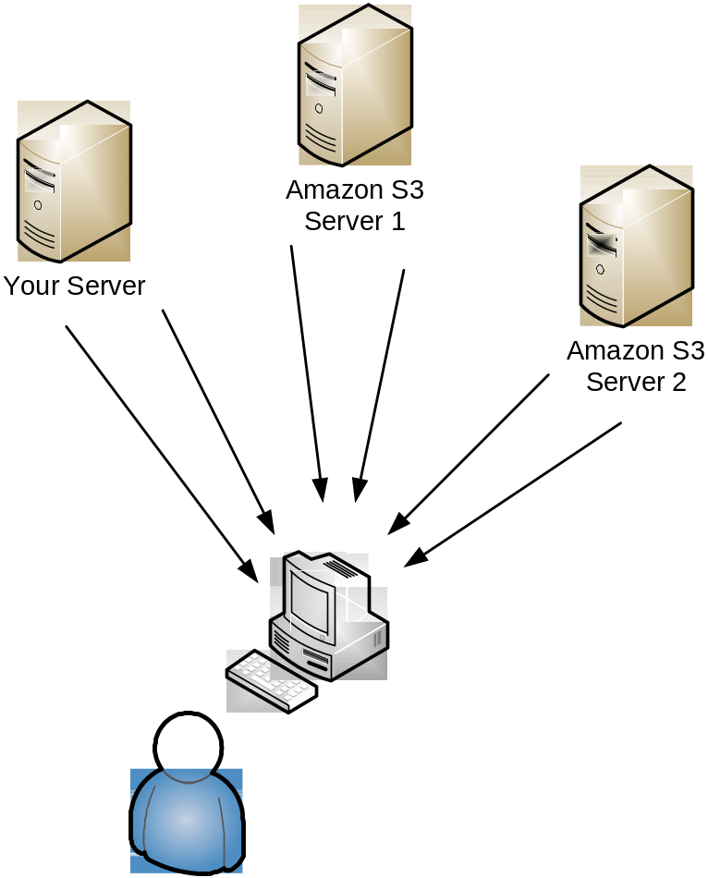
Distributed Assets
Notes:
At the simplest is S3, or the Simple Storage Service provided by Amazon.
S3 is basically a hard drive in the sky, and there is little in the way of provided services.
The platform is not an operating system at all in the strictest sense –
you wouldn’t really write an application and plop it up on S3 and forget about it like you would with your ISP or server farm.
S3 is appropriate for applications that need to make use of distributed assets.
social networking sites put the photos that users share on S3
simple push and pop mechanism is perfect for the storage of large binary objects like photos
the services make it easy to get the photos up and draw them back again.
Because it is priced like a utility, the social site doesn’t have to pay the large capital expense that would be required if they bought all of the servers necessary to handle the largest possible load.
Even smaller sites can make use of a service like S3.
project I recently completed
poorly performing web application
store its numerous web graphics, stylesheets and javascript files on S3.
This gets around the asset deployment problem that plagues web sites,
since most browsers only download two items at a time from a given domain.
Additionally, it reserves the application’s bandwidth for business-critical operations.

Slide 43
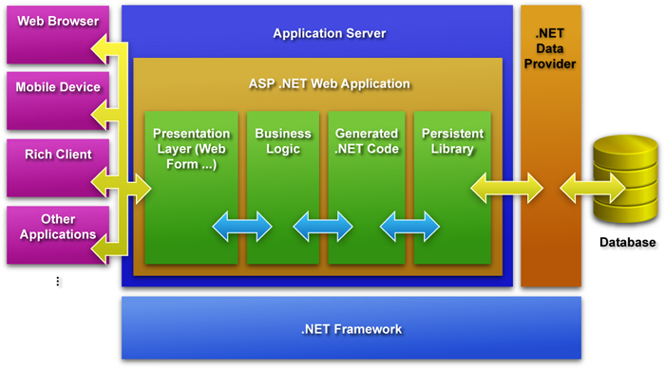
Azure ≈ ASP.NET
Notes:
The richest existing cloud implementation to date is Microsoft Azure.
Azure is a place that you can use to plop your whole application in the cloud and forget about it.
It is built on the .NET framework, and allows unmanaged code as well, so even a PHP or Ruby on Rails product could be uploaded wholesale.
Additionally, they provide a host of other services, from weather lookup to Live Login for authorization and authentication.
Azure is a platform that you would design and build a whole product for.
Microsoft provides tools as part of Visual Studio that allow you to create an ASP.NET web application,
and just publish it right to Azure just like you would copy it to your web server.
It is essentially a very large, very powerful, very scalable hosting provider that happens to be billed like a utility.

Slide 44
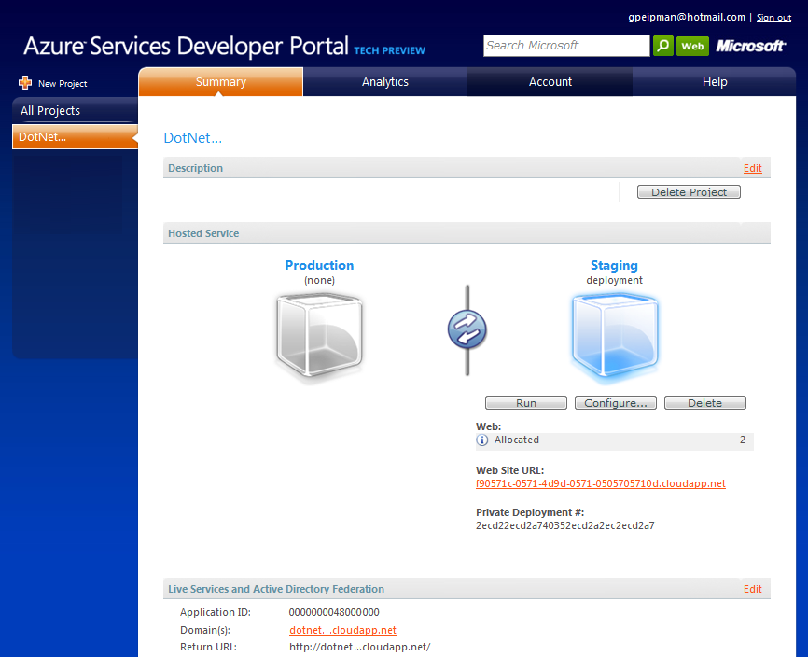
Azure portal
Notes:
In addition, you pick the deployment.
Do you need a database server, a business logic server and two web servers?
Configure it right from the web.
Have you found that the database is struggling under the load?
Just fire up another one.
Unlike the shard computing approach used by Google and Amazon,
Microsoft is making rich use of virtualization to provide server utility.
Why is it a cloud then?
Two reasons – it is priced like a utility, only charging for the bandwidth and cycles used.
Second, it provides certain services, like the SQL Data Service, which is essentially a database in the cloud.
While Azure blurs the lines between cloud computing and just using a good ISP, it certainly is part of the conversation.
So Azure is good if you have a program that is already written for a supported engine,
like ASP.NET especially,
and want to place the whole app in the cloud.
The back end of the system will need to be rewritten to make use of SQL Data Service,
which is something of a barrier to entry, but the additional services you get might be worth it.
If the application converges with anything connected to Windows Live or anything that COULD be connected to Windows Live,
it’s a sure bet that a small rewrite for Azure will be worth it.

Slide 45

Google Apps
Notes:
Google Apps has taken things a whole different direction.
They are keeping the cloud, and just giving you the services.
The problem with that is that you have zero control over the data itself.
The benefit is that it is free, at least right now.
I have a hard time arguing with free.
So Google is a strong contender
if you have an application that resides in the browser,
and could make use of the services already provided by Google.
Does your application need search capabilities?
How about manage documents or images?
Google has an app for that.
The services provided by Google Gears would give you a key in to using
Google Search,
Google Docs or
Picassa
for your needs in that particular area.
This is a good simple fast and cheap way to add a feature that users might be longing for to an existing application.
Google Apps isn’t a great place to store things, or move your program to, but it does provide a lot of bang for just a little buck.

Slide 46
Implementation
Select a vendor
Prepare the application
Change to processes
Notes:
Obviously, application preparation depends heavily on the style of cloud you are heading for.
In general you are looking to do more or less the same kind of design changes to a cloud implementation
that you are when going to a server farm –
because that is often what you get.
The two most common trouble areas in preparing your application are transactional support and security.

Slide 47
Supporting transactions
Public Sub Order(ByVal widget As Product, ByVal quantity As Integer)
SyncLock widget
Try
If quantity > widget.Inventory Then
Throw New ApplicationException("We are out!")
Else
widget.Ship()
End If
Catch ex As Exception
Debug.Print(ex.Message)
End Try
End SyncLock
End Sub
Notes:
The transactional problem is a common one.
If a customer in San Diego is looking to buy your last widget,
and a customer in Boston is looking at the same widget, they both have a chance of ordering that self same widget,
and both expecting to get it.
Usually, in a single server context the solution is to lock the thread containing the widget object, using a Singleton model, as shown here.
This won’t work in a multi-server environment, however.
Since the thread is only locked on one server,
two users could still potentially order the same widget,
and Inventory would be a negative number when it was all said and done.
We don’t want that, especially is the item is BlueJackets playoff tickets or the like.
We need the system to be able to lock across multiple servers.
In his book Cloud Application Architectures, George Reese talks about a few solutions to this problem.
The first and most common solution to this is to perform your transactional logic to the database,
and use a stored procedure to perform the business processes.
Neither George nor I are a great fan of this option,
as it leads to unmanageable code,
and even more vendor lock-in.
Also, if working in a shard environment,
there is a good chance that state will still not be managed correctly.
Another possibility that seems to be gaining traction in the cloud community is using a shared locking system,
usually in the database itself.
Before performing business logic,
the database could check a table of locked objects for the identifier to the object being processed.
If found, it would wait.
If not found,
the identifier would be stored for its own thread,
the processes performed,
and then the lock would be removed.

Slide 48
Moving to the database
BEGIN TRANSACTION OrderTransaction
BEGIN
IF @onhand < @quantity
BEGIN
PRINT “We’re out!”
ROLLBACK
END
ELSE
BEGIN
INSERT itemnumber, quantity INTO orders
COMMIT
END
END
END
Notes:
Of course, many database vendors have existing transactional mechanisms,
like SQL Data Service in the Microsoft Azure system.
Microsoft has implemented a Tabular Data Stream model overtop of the property bag schema
that is the foundation of SQL Data Services.
The Tabular Data Stream supports client transactions just as SQL Server would
with a BEGIN and END TRANSACTION statement.
If you can let the tools work for you, then do so.

Slide 49
Assume insecurity
Encryption
Security Management
Internal Security
Authentication
Authorization
Perimeter Security
Storage Security
Physical Security
Notes:
There is no getting around the core problem of Cloud Computing from the CIO’s perspective –
all of your data is on someone else’s computer.
When designing an application
people rarely have to worry about protecting the application from itself and its environment.
When the server is in your basement,
that just isn’t a problem unless a malicious users gets through the barriers set up,
which is a whole different conversation.
When your data is on the cloud,
you have to remember that all of this virtualization and shard computing aside,
there is still a physical computer somewhere with your database and files on it.
That machine’s security is not up to you,
so you have to assume that it isn’t secured at all.
This is a tremendous challenge.
Mr. Reese has another suggestion for this scenario that I agree with fully, and that is: encrypt everything.
Encrypt your sensitive data within the database.
Encrypt your network data with SSL.
Encrypt the backups.
Obfuscate your binaries.
Act like anyone can walk in and look at the system drive – because in reality they can.
There is some system administrator from Amazon, Google or Microsoft maintaining that system
and he is probably wearing that “I can read your email” tshirt they sell on ThinkGeek.

Slide 50

The kid securing your server
Notes:
Be informed about your vendor’s security policy.
There are a number of articles out there on the various cloud provider sites with 1500 words about nothing
when it comes to the implemented security measures.
We all realize that none of these companies are going to implement weak security,
because the first significant break in the armor might spell doom for that organizations entire cloud effort.
Nonetheless, if you don’t get the answers you want about the provider’s security, press harder until you do.

Slide 51
Implementation
Select a vendor
Prepare the application
Change to processes
Notes:
When you get to the end of the road, you find that some of your processes need change in Testing and Deployment expecially.
Now, Testing and deployment is in essence no different for a cloud application than any other application.
You should be writing your tests as you write your app.
Components should be unit tested.
Check-in requires a passed integration check.
Deployment from source control is still the norm.
Labeling, branching, forking, all of that good stuff still applies.

Slide 52
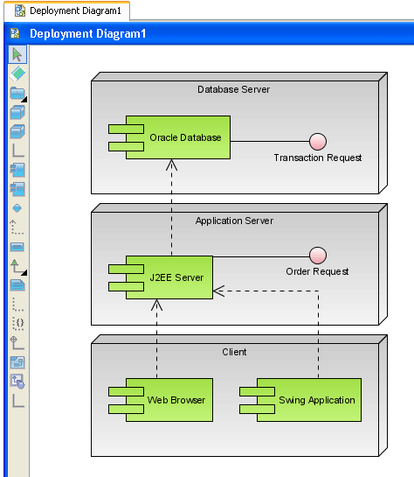
Deployment processes
Notes:
The point I want to make is that you will have to revise the details when you move to the cloud.
If you are using a sharded data model, for instance,
then testing the broad transaction or memory management controls will have to be an expected part of all the unit tests.
Integration testing will have to take the distributed nature of cloud computing into consideration.
Testing in the cloud is slightly different, and your new deployment model must support that.
If you are using an application service provider as your host now,
you likely have a QA box under your desk or in the local server room to do pre-deployment shakedowns.
After the move to the cloud there will no longer be a QA machine under the desk.
Management probably won’t go for a QA Cloud under your desk because you will need a bigger desk.
Decisions will have to be made about development against cloud services, as well.
All of the cloud providers have test implementations of services,
but your QA practices will have to change to take them into consideration.
These are all small things, but they will get overlooked by the upper level decision makers
when cloud computing becomes an organizational reality.
The time and costs involved with changing existing deployment patterns
have to be factored into the total cost of ownership of a cloud application.

Slide 53
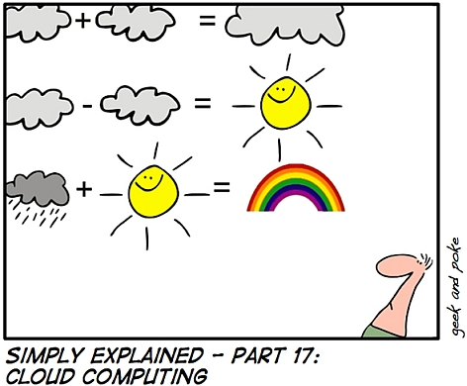
Clear as mud
Notes:
Just as the standalone power generators of the last century gave way to the electric utility grid,
it seems that the corporate server farms of the last decade are already giving way to computing power served up as a utility.
Without technologies like
the Internet,
virtualization and
shard computing,
cloud computing would still be a farfetched idea,
but the time has indeed come.
We have seen that the reduction in capital expense
that is provided by the implementation of cloud computing has the benefit of
flattening and lowering the supply curve,
making new goods cheaper for longer.
It also has the benefit of changing the tax landscape,
making it a sound investment for large corporations.
Finally, I think we have shown that the cash savings it provides
gives small and large businesses the wherewithal to grow at a more reasonable pace,
and massage the business cycle in their own way.
Implementation of cloud applications will be a reality for quite a few of you,
and I hope the few implementation details I have provided will be helpful.
The choice of vendor is dependent on your applications needs.
All of those applications will need to be analyzed for best utilization of the cloud services.
Finally, deployment procedures, along with security and testing, will need to be revised.
Cloud computing might be the ‘next big thing’
or it might just be the next thing,
but either way it makes a lot of sense in this economic environment.
The scalability it offers,
and the cost savings that most companies will see,
are good reasons to consider it for your suite of applications.

Slide 54
References
"Centennial Keynote Address," John McCarthy. MIT, 1961.
"Cloud computing," Next Generation Education Project, Wiki, 2008.
"Cloud Computing for the Masses," Tim O'Reilly, 2008.
The Big Switch, Nicholas Carr. W. W. Norton, 2008.
“The Economics of Cloud Computing”, Open Source Magazine, 2009
Cloud Application Architectures, George Reese. O’Reilly, 2009.

Slide 55
URLs
http://www.microsoft.com/azure/default.mspx
http://aws.amazon.com/s3/
http://www.google.com/apps/intl/en/business/index.html
http://www.enstratus.com/page/1/blog.jsp

Slide 56
Thank you!
If you have any questions, I can be reached at wsempf@iccohio.com
My blog is at www.sempf.net.
My twitter address is @sempf
I am on LinkedIn at bill@pointweb.net.
I am on Live Messenger at sempf@hotmail.com.

